Slide 1
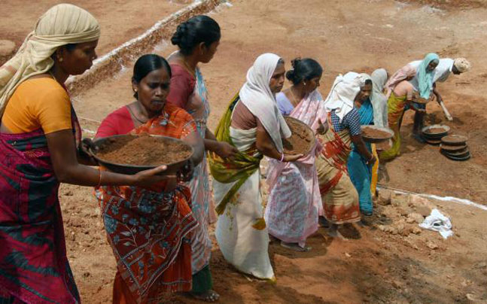
ATTENDANCE MONITORING SYSTEM FOR MGNREGA
Batch no 25:
A Srikanth reddy(178W1A1261)
A Mahendra(178W1A1262)
I N N Krishna Sai(178W1A128)
R Ganesh(178W1A12B0)
GUIDE:
Dr. Y. Sangeetha
Associate Professor

Slide 2
Agenda
Abstract
Problem statement
Problem scope
Literature survey
Requirement specification
Architecture diagram
Implementation plan
Implementation code
Output
References

Slide 3
ABSTRACT
The main purpose of this project is to reduce the one of the problems faced by the workers who works under MGNREGA in villages. The problem is that every day a group of 30-40members goes to some work, which is based on MGNREGA (Mahatma Gandhi National Rural Employee Guarantee Act). This work is assigned by their leader, who takes attendance on every working day. On this process if anyone is absent on working day, he/she will take their sign on next following day. By this, for those days who are absent to work also get money and the people who worked on that day will lose their money. To store the details of the workers we are using MYSQL data servers and HTML, CSS, PHP codes for creating the web pages. Node MC Module is used to aces the Fingerprint of the worker. After getting the finger it checks for validation and displaying the login details of the worker. By using the Biometric we can reduce the corruption in the MGNREGA Act. Doing this way every worker in this Act will be benefited and satisfied with their money.

Slide 4
National Rural Employment Guarantee Act 2005 (or, NREGA No 42, later renamed as the "Mahatma Gandhi National Rural Employment Guarantee Act“).
MGNREGA), is an Indian labour law and social security measure that aims to guarantee the 'right to work’.
The act was first proposed in 1991 by P.V. Narasimha Rao.
It was finally accepted in the parliament and commenced implementation in 625 districts of India.
Another aim of MGNREGA is to create durable assets (such as roads, canals, ponds and wells).

Slide 5
Problem Statement:-
Village peoples are doing work in MGNREGA(Mahatma Gandhi National Rural Employee Guarantee Act) and getting wages according to their work.
In this for every 30-40 members a leader will be allotted by the government.
These leaders will take the attendance daily and guide the people to do work.
Some peoples are misusing their job and giving attendance even though they did not came to do work.
So the worker who work on those days will loose their money for their work.

Slide 6
Our solution
Here we decided to implement finger print process to take attendance of the workers. This device will work only in the period of working time.
Leader will take attendance daily with fingerprint device and store that information in database.
Whenever leader want to check that details he/she will able to see that list of workers who are attended on particular days.
Leader also import the daily, weekly, monthly reports of the worker in the form of Excel sheets.

Slide 7
Project scope
The main is to reduce bribery and to help worker to get their money for their work.
To reduce the workers laziness.
To distribute money equally for all workers who worked .
To reduce corruption.
To reduce misunderstanding between workers.

Slide 8
Literature Survey
Paper 1
G. Chandra Ph. D. Research Scholar “A Study on Mahatma Gandhi National Rural Employment Guarantee Act Opportunity and the Corruption (MGNREGA)” international Journal of Management Research and Social Science (IJMRSS) ISSN 2394-6407 Volume 2, Issue 1, January - March 2015 ISSN2394-6415
The Government of India has introduced many employment generation programs to eradicate poverty and unemployment, since in 1980. Many of the employment program failed due to the common problems of ineffective targeting, leakages and poor quality asset creation, etc. Hence, while developing rules and guidelines for implementation of the MGNREG Act 2005, more attention should be paid to the lessons we have learnt from past experiences. Because this act has the potential not only to strengthen social security in India, this program will generate work for the poorest; it is also an opportunity to increase the stranded of living, but also there is corruption in the MGNREGA, no question about that. But simple indices that claim to measure corruption and make an assessment of interstate levels of corruption can end up offering us a wrong understanding. In countries at all stages of development. So we will eradicate the corruption in our country in our country become a very big developed country in the world.
Drawbacks:
Here they are not implemented any biometric device for their project to recognize the fingerprint.

Slide 9
Paper 2
A. Santhhappan Ph. D. Research Scholar “Job Cards in MGNREGA Registered International Journal of Trend in Scientific Research and Development(IJTSRD)
The flagship program of the Indian Government MGNREGA(Act) is aiming at enhancing the livelihood security of the rural households through guaranteed100 days of manual wage employment in a fiscal year to its adult member, who is willing to do manual work. There is a registration process involved to obtain job cards for benefiting from this program. Even though the process looks like simple steps, it involved time, labor and money the intended beneficiaries to register and obtain the job cards. Insufficient clarity and understanding from the parts of both the implementers and beneficiaries, more people than the actual beneficiaries have registered and obtained job cards under this scheme, through which the implementers spent lot of time, energy and money on providing the job cards as well as keeping the data base. This article analyses the cause and effect of more number of registration and brings out some suggestions to avoid over burdening with more data and keep the beneficiaries with more clarity on the program for effective participation.

Slide 10
Paper 3
Rajesh Sharma, DR. Manish Diswania, “PERFORMANCE ANALYSIS OF MGNREGA” ENITH International Journal of Business Economics & Management Research_ISSN2249-8826ZIJBEMR,Vol.3(8),August(2013)150
Rural Development is the one of the major objectives of the socio-economic program implemented by the Central and State governments in India. Some of the program are very much target oriented and playing vital role in this area. MGNREGA (Mahatma Gandhi National Rural Employment Guarantee Act) is one of the program who has attained considerable recognition among rural masses and significantly uplifting the livelihood by creation of new jobs and involving rural people in some of the States. This study revealed that there is a noteworthy improvement in the awareness level among the beneficiaries in rural areas and positive effects of much target oriented and playing vital role in this area. MGNREGA (Mahatma Gandhi National Rural Employment Guarantee Act) is one of the program who has attained considerable recognition among rural masses and significantly uplifting the livelihood by creation of new jobs and involving rural people in some of the States. This study revealed that there is a noteworthy improvement in the awareness level among the beneficiaries in rural areas and positive effects these program especially in villages can be identified. Now rural local bodies such as Gram Panchayats are also actively participating in the rural development process. In this paper an attempt has made to evaluate the financial and physical progress under MGNREGA in the District Jind of Haryana State. The positive impact of MGNREGA in Jind district cannot be ignored; which is an encouraging indicator for State and Central governments. It has also been suggested in the paper that; in future, more such target oriented programmers should be implemented so that, the gap between poor and rich and rural and urban areas could be bridged.

Slide 11
Requirement specifications
MYSQL server to store the workers database.
HTML codes for creating web pages.
PHP for Web pages.
CSS for styling.
NODE MC Module and Finger Print Module for creating fingerprint device.

Slide 12
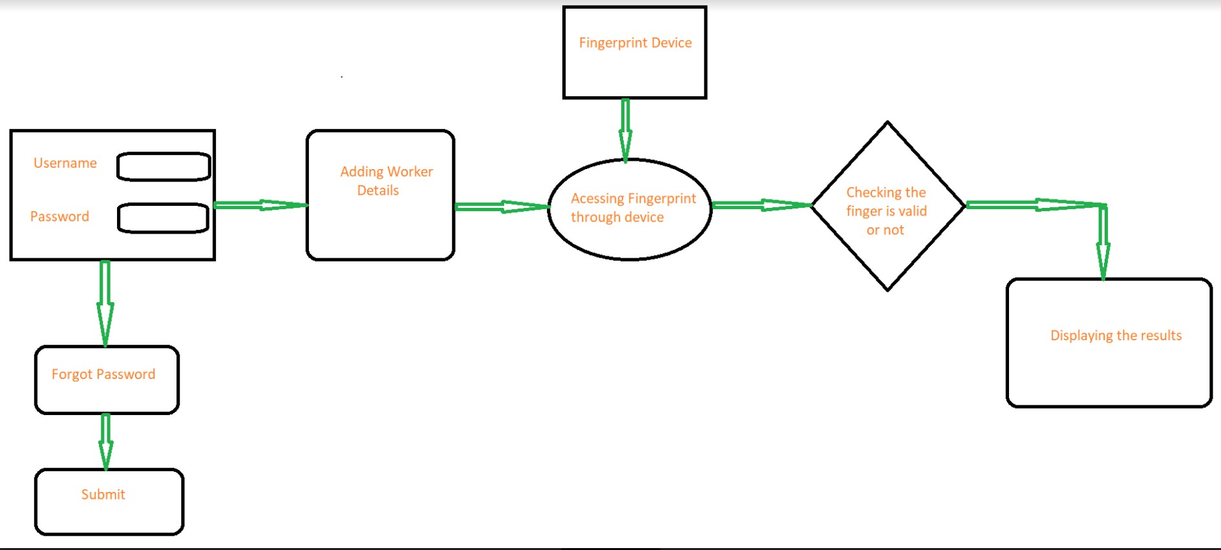
Architecture Diagram

Slide 13
Implementation Plan
We are taking data of workers from the panchayts or from the workers themselves. All the data will be stored in the Mysql database.
We are implementing the web pages and that enable leaders for the login and access it.
After the leader login all the workers under the leader will be displayed.
Then the leader will take the attendance through the finger print device and check whether that finger print is matched or not that is in the database.
If the finger print matched then attendance will be provided for that worker.
Finally leader can see the daily, weekly, and monthly reports of the worker and export that data in the form of excel sheet to higher authorities.

Slide 14
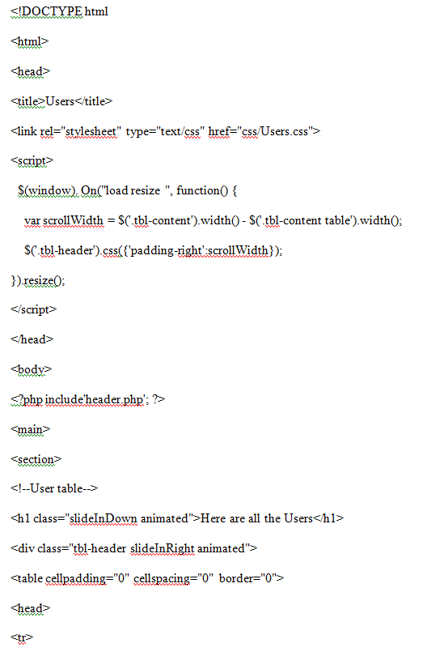
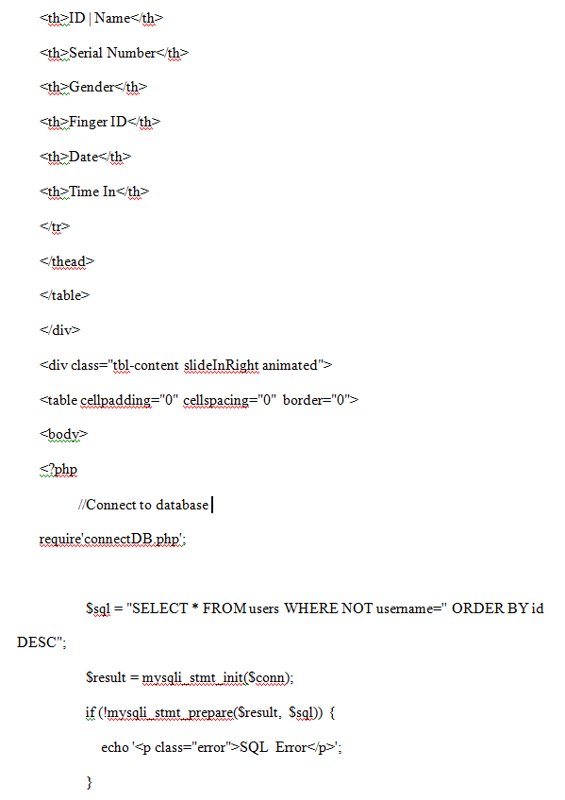
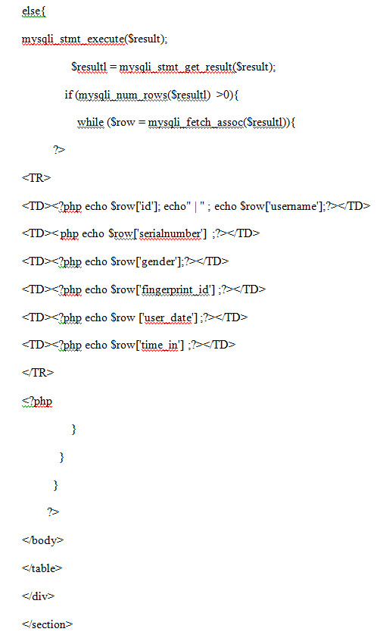
Implementation of code

Slide 15

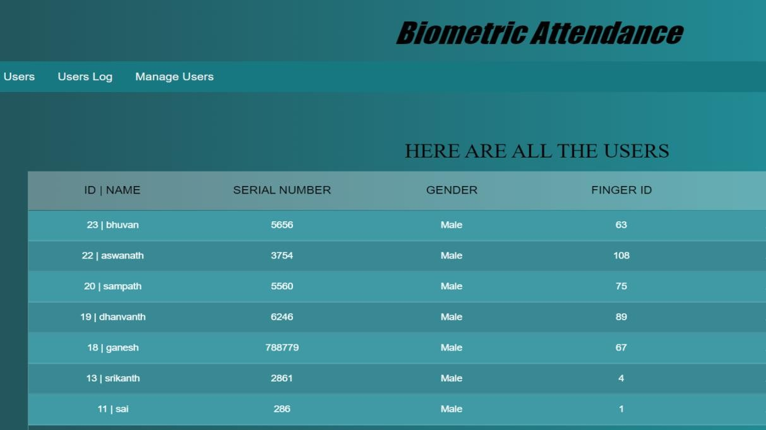
Output

Slide 16
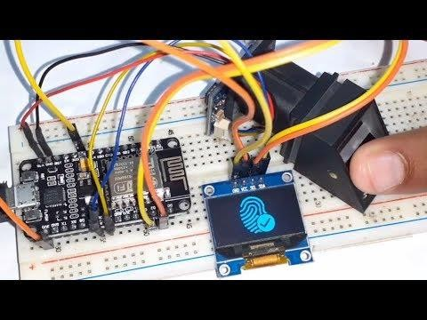
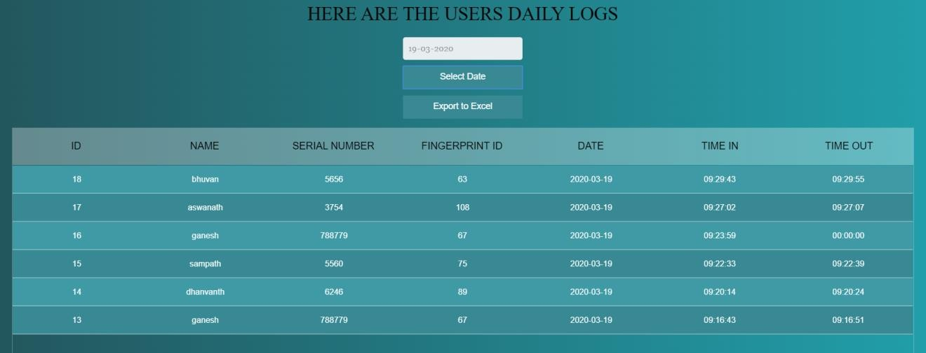

Slide 17
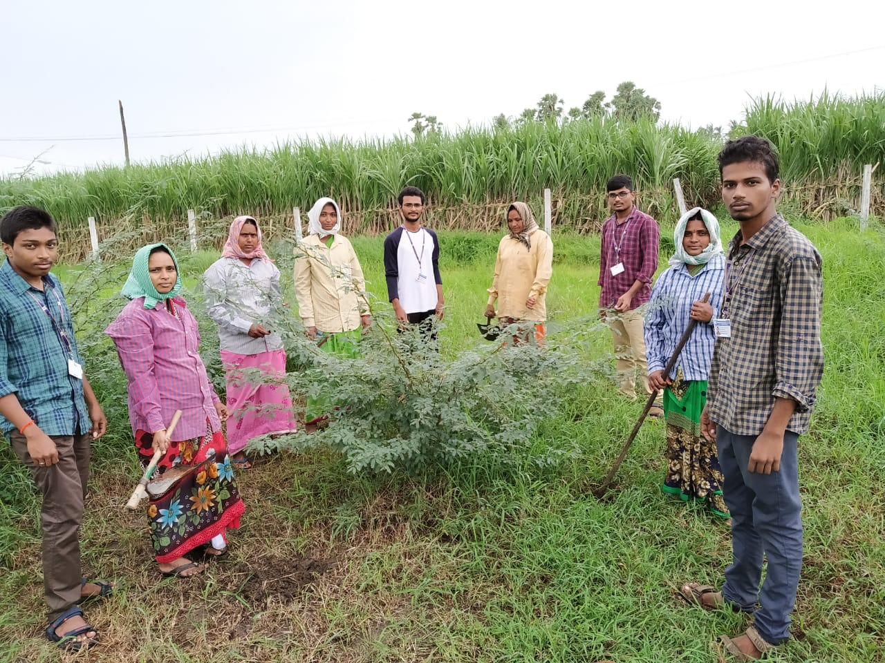
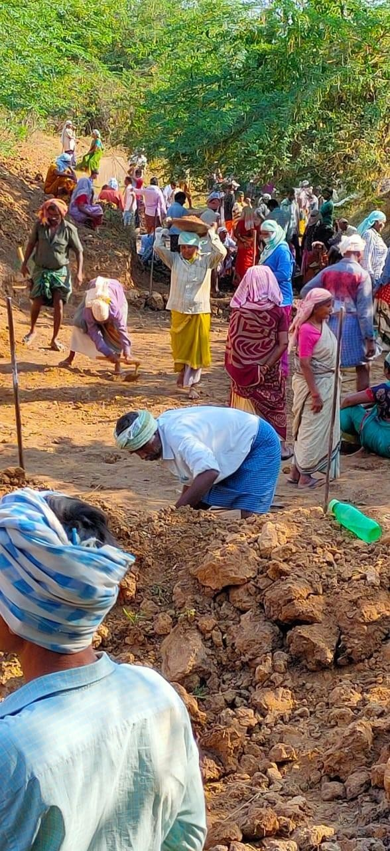
Field Work

Slide 18
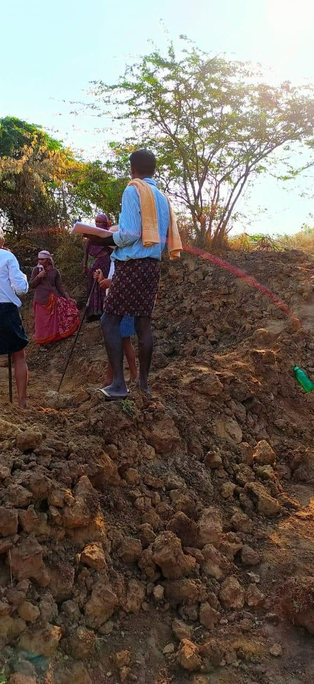
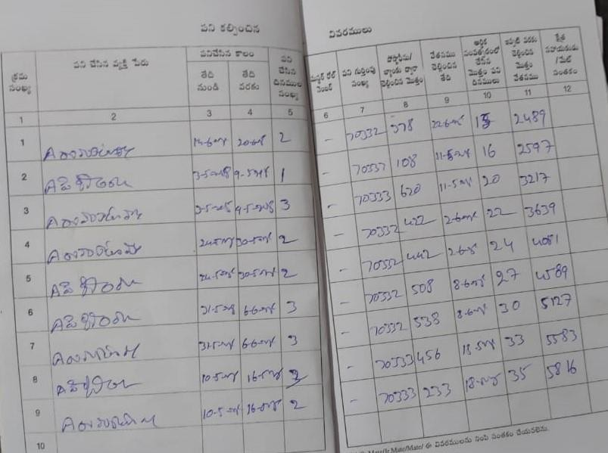

Slide 19
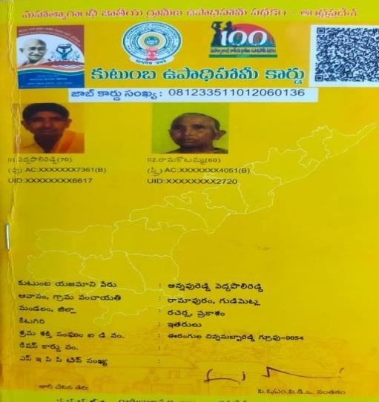
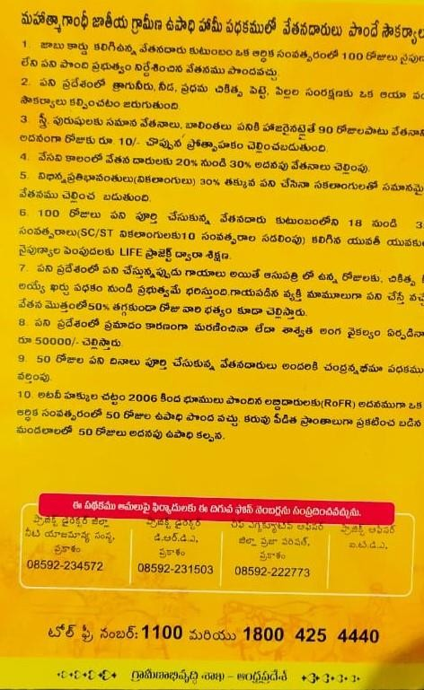

Slide 20
References
G. Chandra Ph. D. Research Scholar, Dept. of Dr. Ambedkar Centre for Economic Studies, University of Madras “A Study on Mahatma Gandhi National Rural Employment Guarantee Act Opportunity and the Corruption (MGNREGA” International Journal of Management Research and Social Science (IJMRSS) ISSN 2394-6407 Volume 2, Issue 1, January - March 2015
Rameez Hassan Department of Economics, AMU ,Aligarh Owais Hassan Magray Aligarh Muslim University, AMU, Aligarh “Impact on MGNREG on Tribal live hood in Jammu and Kashmir, India” International Journal of Research and Analytics Reviews(IJRAR)2019 IJRAR June 2019,Volume 6,Issue2
Saha S (2014) Women Work Issues in Rural Development “A Case of MGNREGA Implementation in west bengal, India”. Global Journal of human-Social Science 14:49-52.
Rahul Baahugunaa, Aakhilesh Chaandra Pandey, Vishal Soodan A Study On Economic Impact Of MGNREGA On Beneficiaries In Rurdrapryag “International journal Of Management and Applied Science”, ISSN:2394-7926
Basharat Bashir Bhat, Dr. P. Mariyappan “Impact on MGNREGA on Rural employment” International Journal of Humanities and Social Science Research ISSN: 2455-2070 volume 2; Issue 3; March 2016.
Rhonda Breitkreuz, Carley-jane Stanton, Nurmaiya Brady “The Mahatma Gandhi National Rural Employment Guarantee Scheme: A Policy Solutions to Rural Poverty in India” Development policy Review, 2017, 35(3):397-417

Slide 21


